Slide 1
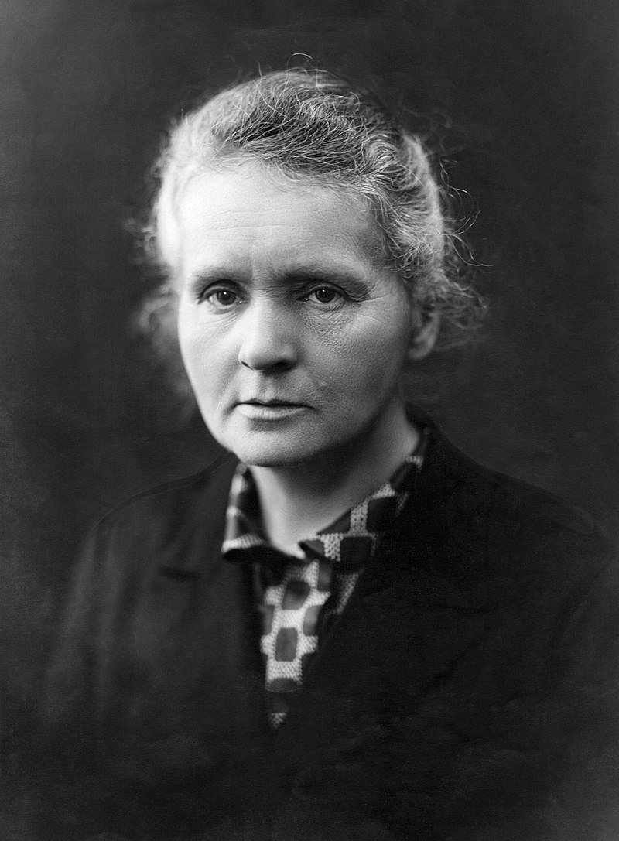
Marie curie
Rosa parks
Malala yousafzai
Greata th.
She was born in Warsaw, in what was then the Kingdom of Poland, part of the Russian Empire. She studied at Warsaw's clandestine Flying University . In 1891, aged 24, she followed her elder sister Bronisława to study in Paris, where she earned her higher degrees and conducted her subsequent scientific work. In 1895 she married the French physicist Pierre Curie, and she shared the 1903 Nobel Prize in Physics with him and with the physicist Henri Becquerel for their pioneering work developing the theory of "radioactivity"—a term she coined
MARIE
curie
Influential people in history

Slide 2
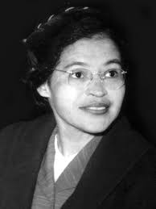
Rosa parks
Marie curie
Malala yousafzai
Greata th.
Rosa Louise McCauley Parks (February 4, 1913 – October 24, 2005) was an American activist in the civil rights movement best known for her pivotal role in the Montgomery bus boycott. The United States Congress has honored her as "the first lady of civil rights" and "the mother of the freedom movement".^{[1]} Parks became a NAACP activist in 1943, participating in several high-profile civil rights campaigns. On December 1, 1955, in Montgomery, Alabama, Parks rejected bus driver James F. Blake's order to vacate a row of four seats in the "colored" section
ROSA
PARKS
Influential people in history

Slide 3
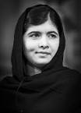
Marie curie
marie curie
Rosa parks
Malala yousafzai
Greata th.
Malala Yousafzai was awarded the Nobel Peace Prize for her fight for the right of every child to receive an education. She was born in the Swat Valley in Pakistan. When the Islamic Taliban movement took control of the valley in 2008, girls’ schools were burned down. Malala kept a diary of the events, which was published in 2009 by BBC Urdu. In her diary she spoke out against the Taliban’s terrorist regime. An American documentary film made Malala internationally famous.
MALALA
YOUSAFZAI
Influential people in history

Slide 4

Marie curie
Marie curie
Rosa parks
Malala yousafzai
Greata th.
Greta Thunberg, in full Greta Tintin Eleonora Ernman Thunberg, (born January 3, 2003, Stockholm, Sweden), Swedish environmental activist who worked to address the problem of climate change, founding (2018) a movement known as Fridays for Future (also called School Strike for Climate).
GREATA
THUNBERG
Influential people in history

